Slide 1

PROJECT AIRBNB
Seattle
By Group 1 - AA/B

Slide 2

AIRBNB SEATTLE
We have used the latest data available on the below website.
Dataset: http://insideairbnb.com/seattle/

Slide 3
OBJECTIVE
Airbnb is imperative to gather information about the aspects that affect price in order to keep alert and thus provide the finest service and price.
We want to understand customers understanding while giving the ratings
Based on the beds, availability and the timeline through out the year we want to understand the behaviour

Slide 4
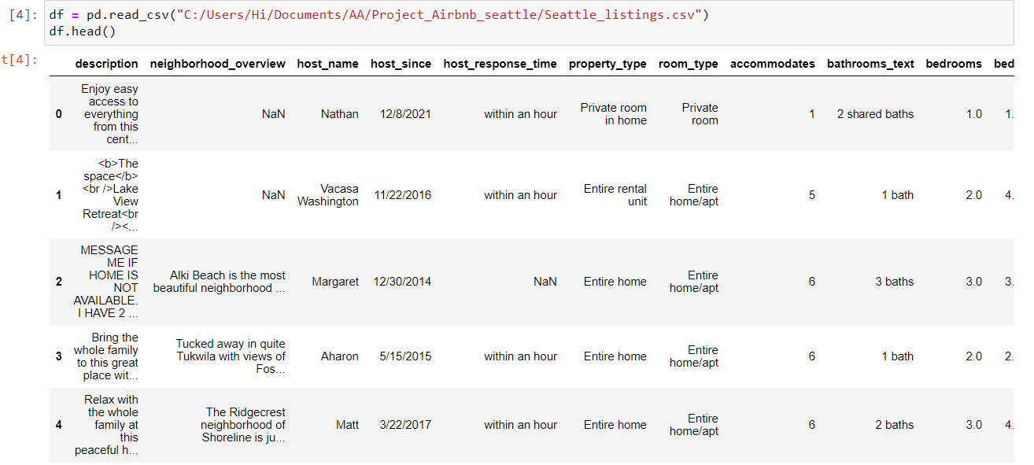
DATASET

Slide 5
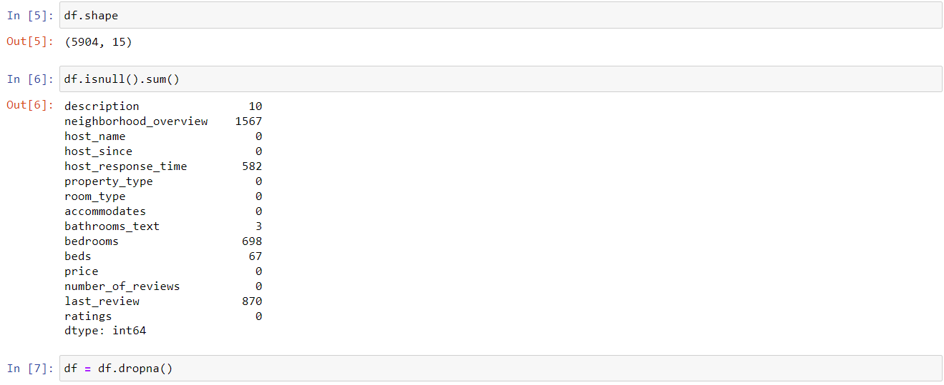

Slide 6
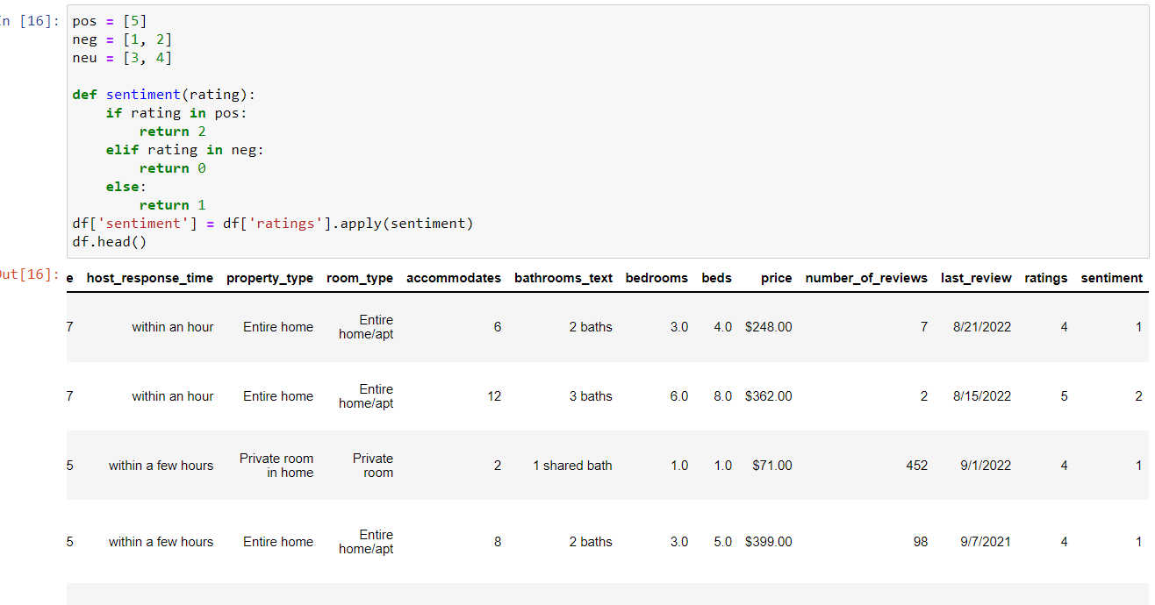
Descriptive Analysis

Slide 7
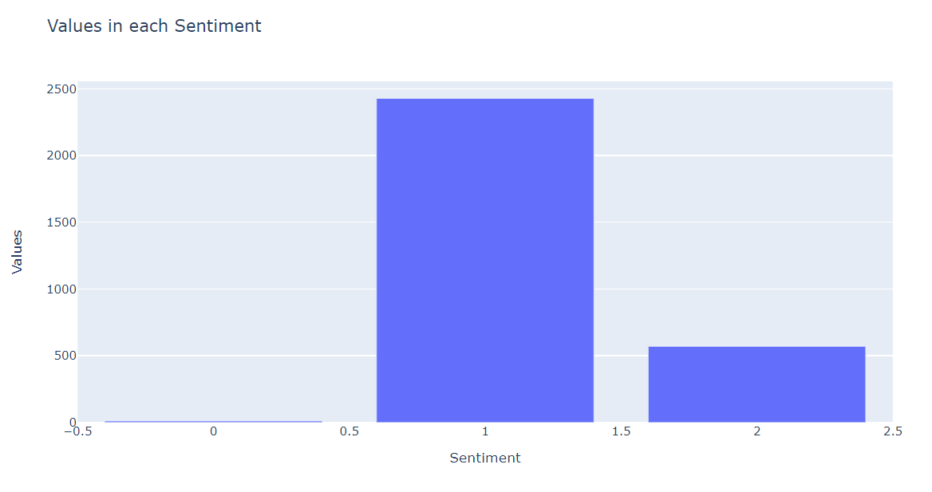

Slide 8
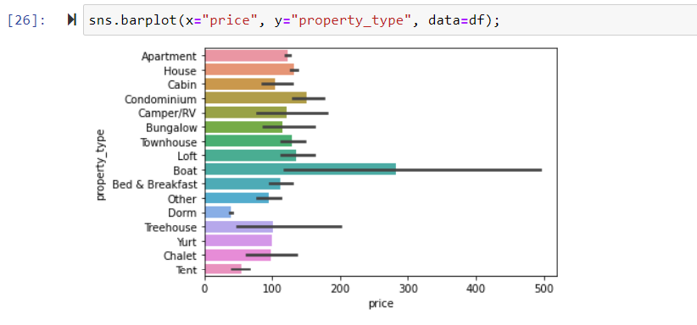

Slide 9
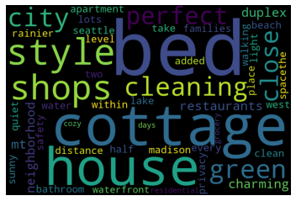
Word Cloud

Slide 10
Proposed Techniques for data analysis
Decision Tree Classifier (to predict accuracy)
Naïve Bayes Classifier (to predict accuracy)
Logistic Regression

Slide 11

THANK YOU

